Slide 1
The LionWeb Initiative
Strumenta Community Panel, January 2024
Niko Stotz & Jos Warmer

Slide 2
LionWeb Project Overview

Slide 3
Mission
To create an ecosystem of interoperable components for building language-oriented modeling tools on the web.
Adopt language engineering
Reduce technology/vendor lock-in
Mix and match components
Foster innovation and incremental improvements

Slide 4
Why – Rationale
Most mature LWBs desktop-based
Everything needs to be web
Huge re-engineering effort
Language Engineering landscape is fragmented
Strong tool lock-in
Many interesting tools/component that you would like to use
… but … you cannot
Everybody has to keep reinventing the wheel
Our community is too small to afford this, we can only grow if we can benefit from each others work
LionWeb: Language on the Web
Interfaces
Interoperability
Integration

Slide 5
How – Principles
LionWeb as boring, reliable base
Innovate on top
Rough consensus & Running code
Yoyo approach
Everything is a model
Markus Voelter’s Whitepaper
“A Platform for Systems and Business Modeling”
Business-friendly Open Source
Apache 2.0 license
Spec
Code

Slide 6
What are we working on
Interoperability
meta-metamodel
serialization format
Protocols
Bulk protocol
Delta protocol
2023.1 Release
Next release(s)
Programming APIs
Java
Kotlin
TypeScript
JavaScript
Tool integrations
MPS
Starlasu
Freon
Ecore
Repository
Reference implementation of protocols

Slide 7












What not – Out of Scope
Yet another Language Workbench
Plug-and-play component system
Deployment scheme
Etc. etc. etc.

Slide 8
Technical Overview

Slide 9

Reference Architecture: Parts
Clients
Editors
Visual
Projectional
B
C
A
F
G
1
G
D
Processors
Model checker
Importer
Generator
2
C
F
E
D
Repository
Models
Original
Derived
E
A
JSON &
protocols
B

Slide 10
Reference Architecture: Protocols
1
2
5
4
3
Bulk
Load model, modify, store it back
Delta
Initialise with model, get notified of changes, write back changes continuously
2
5
1
4
Load, derive something else
3

Slide 11
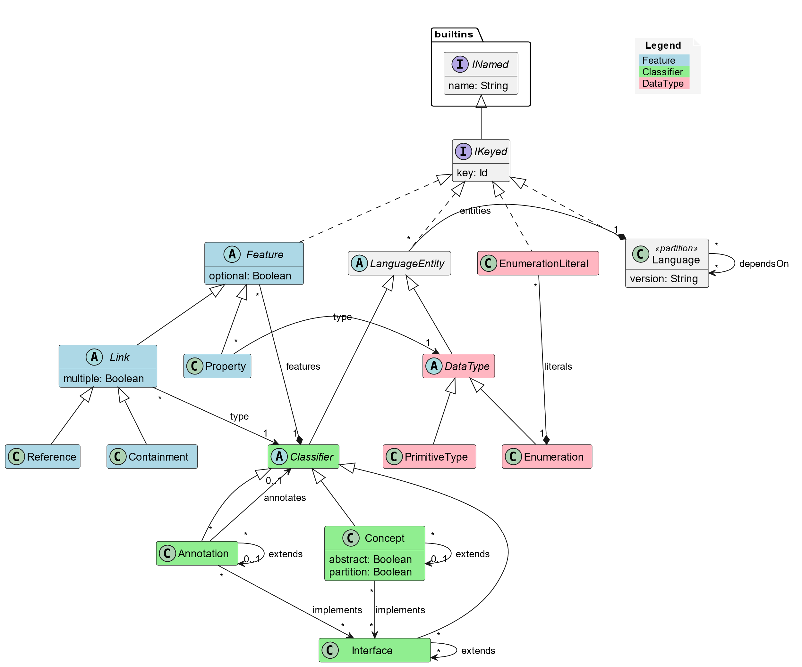
Meta-Metamodel

Slide 12
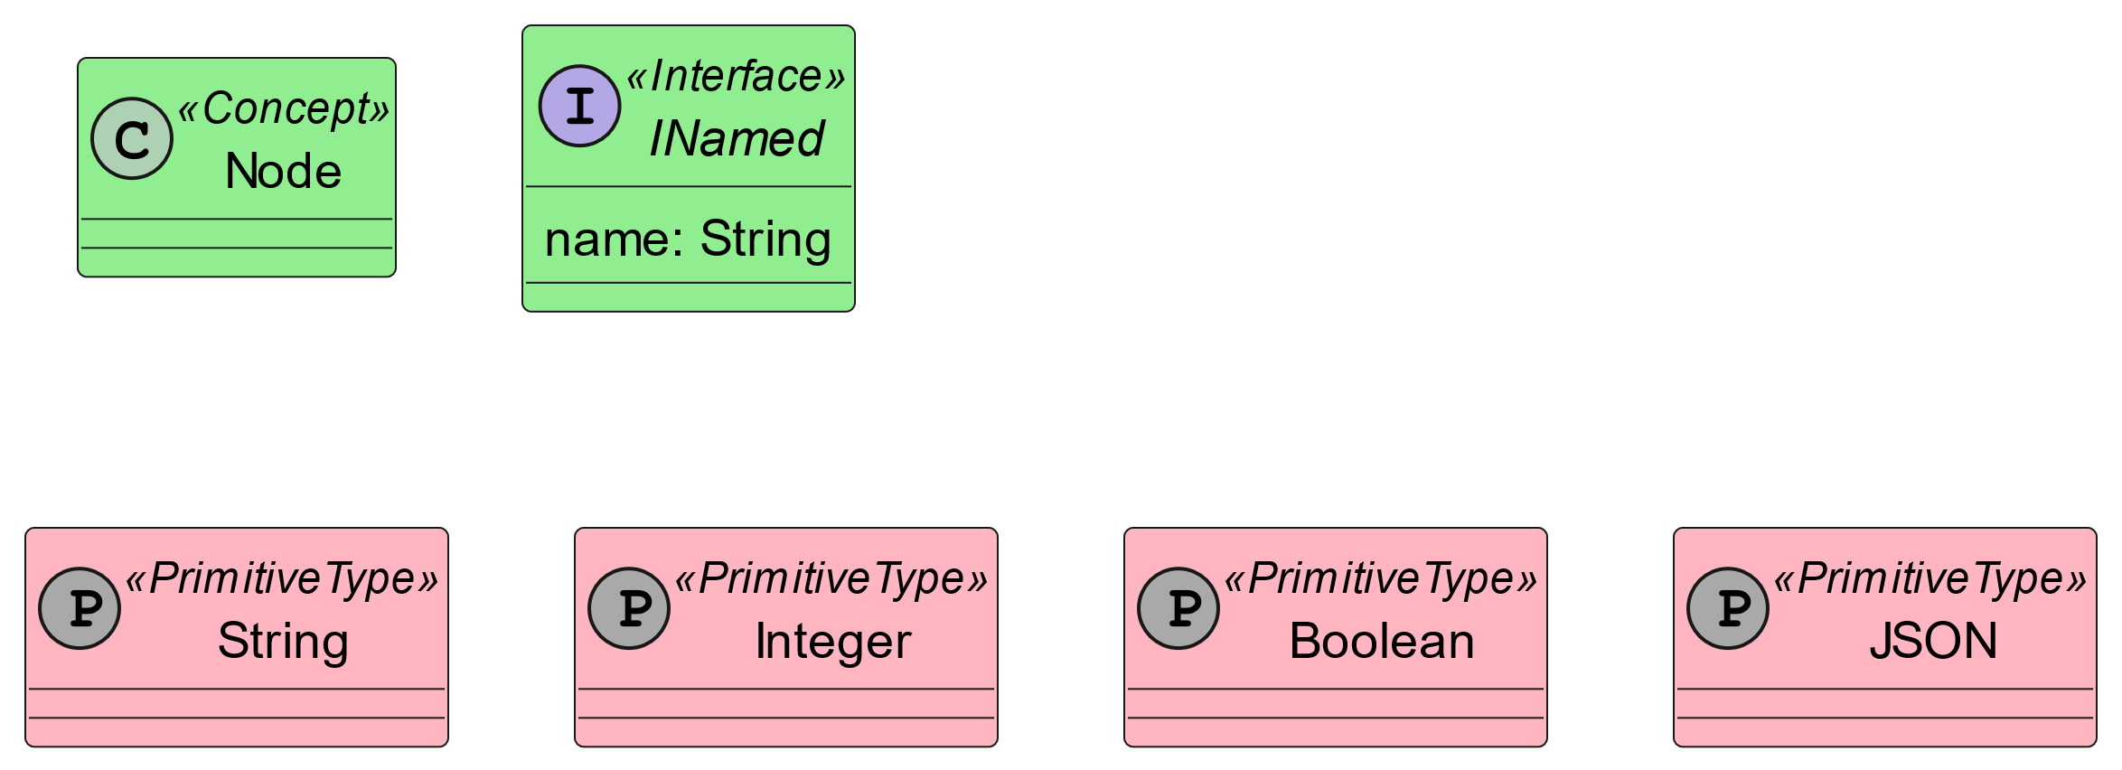
Built-in Meta Model Standard Library

Slide 13
Showtime

Slide 14
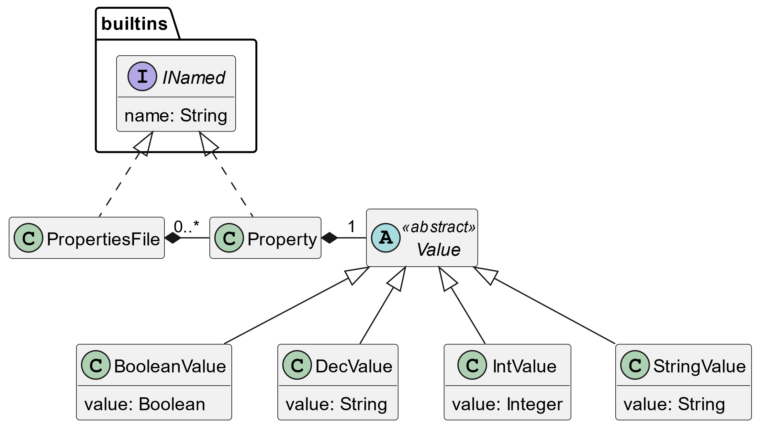
Example Metamodel: PROPS Language

Slide 15
Example file: example1.props
integerProp = 1 LIonWeb_integrates = true myString = "Hello, StarLasu, MPS, and Freon!"

Slide 16
Using MPS to create PROPS language
Language Engineer Flow
LionWeb PROPS metamodel
Kotlin Converter
MPS Converter
Freon Converter
Ecore Converter
Kotlin PROPS
classes
MPS PROPS Language
Freon PROPS language
Ecore PROPS language
Kotlin PROPS Application
MPS with PROPS language
Freon PROPS Web Editor
Ecore PROPS language + Xtend

Slide 17
Properties file
1
End User Flow
Kotlin PROPS Application
8
Changed
Properties file
2
7
PROPS LionWeb
Instance.json
3
MPS with PROPS language
EMF PROPS instance
HTML Page
with PROPS instance
5
6
Freon PROPS Web Editor
4

Slide 18
Demo Contents
Generate LionWeb metamodel from Kotlin classes
Parse properties file and store as LionWeb instance model
Import metamodel into MPS
Convert to MPS languages
Import properties instance model into MPS
Show instance model in Freon web editor, served from MPS via LionWeb protocol
Change some values in Freon
Store changes back to MPS
Export example instance from MPS to LIonWeb
Unparse example instance

Slide 19

LionWeb Team
Meinte Boersma | Freelancer
Norman Koester | itemis (modelix)
Sergej Koscejev | Freelancer
Sascha Lisson | itemis (modelix)
Eugen Schindler | Canon Production Printing
Alex Shatalin | Jetbrains (MPS)
Niko Stotz | F1RE
Federico Tomassetti | Strumenta (Starlasu)
Markus Voelter | Freelancer
Jos Warmer | Freelancer (Freon)
Want to join and work with us:
info@lionweb.io
Want to follow us or use or implement LionWeb:
https://join.slack.com/t/lionweb/shared_invite/zt-1zltq8eqv-QJmtsZA8_oscCrO8HOp3FA

Slide 20
Near Term Focus
Finalize Bulk Protocols and document them
Start Work on delta protocols / collaboration
Refine meta-metamodel
Improve reference implementations and examples
Support integration with more tools

